Slide 1
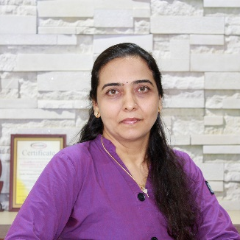
Unit-1: Introduction
Artificial Intelligence (AI)
3170716
Dr. Gopi Sanghani
Computer Engineering Department
gopi.sanghani@darshan.ac.in
9825621471

Slide 2

Outline
Introduction to Artificial Intelligence (AI)
Applications of AI
Looping

Slide 3
Introduction to AI

Slide 4
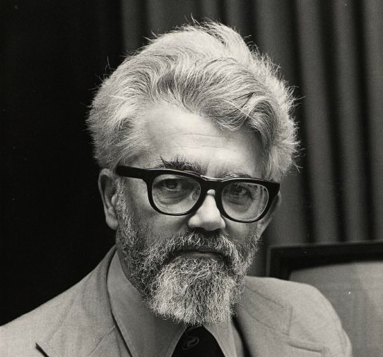
What is Artificial Intelligence (AI)?
AI is a branch of computer science dealing with the simulation of intelligent behavior in computers.
AI is the study of how to make computers do things which, at the moment, people do better.
AI is, the study and design of intelligent agents where an intelligent agent is a system that perceives its environment and takes actions.
AI is the science and engineering of making intelligent machines, especially intelligent computer programs (1956).
John McCarthy
(the father of Artificial Intelligence)

Slide 5
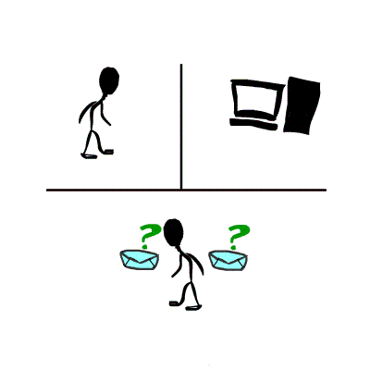
Turing Test
Acting Humanly: The Turing Test proposed by Alan Turing (1950)
A Turing Test is a method of inquiry for determining whether or not a computer is capable of thinking like a human being.
The interrogator job is to try and figure out which one is human and which one is computer by asking questions to both of them.
The computer would try to remain indistinguishable from human as much as possible

Slide 6
AI Techniques
There are three important AI techniques:
Search –
Provides a way of solving problems for which no direct approach is available.
It also provides a framework into which any direct techniques that are available can be embedded.
Use of knowledge –
Provides a way of solving complex problems by exploiting the structure of the objects that are involved.
Abstraction –
Provides a way of separating important features and variations from many unimportant ones that would otherwise overwhelm any process.

Slide 7
Task Domains of AI
Mundane tasks | Formal tasks | Expert tasks
Perception Computer Vision Speech, Voice | Games Go Chess (Deep Blue) Ckeckers | Engineering Design Fault Finding Manufacturing Monitoring
Natural Language Processing Understanding Language Generation Language Translation | Mathematics Geometry Logic Integration and Differentiation | Scientific Analysis
Common Sense Reasoning | Theorem Proving | Financial Analysis
Planning |  | Medical Diagnosis
Robot Control

Slide 8
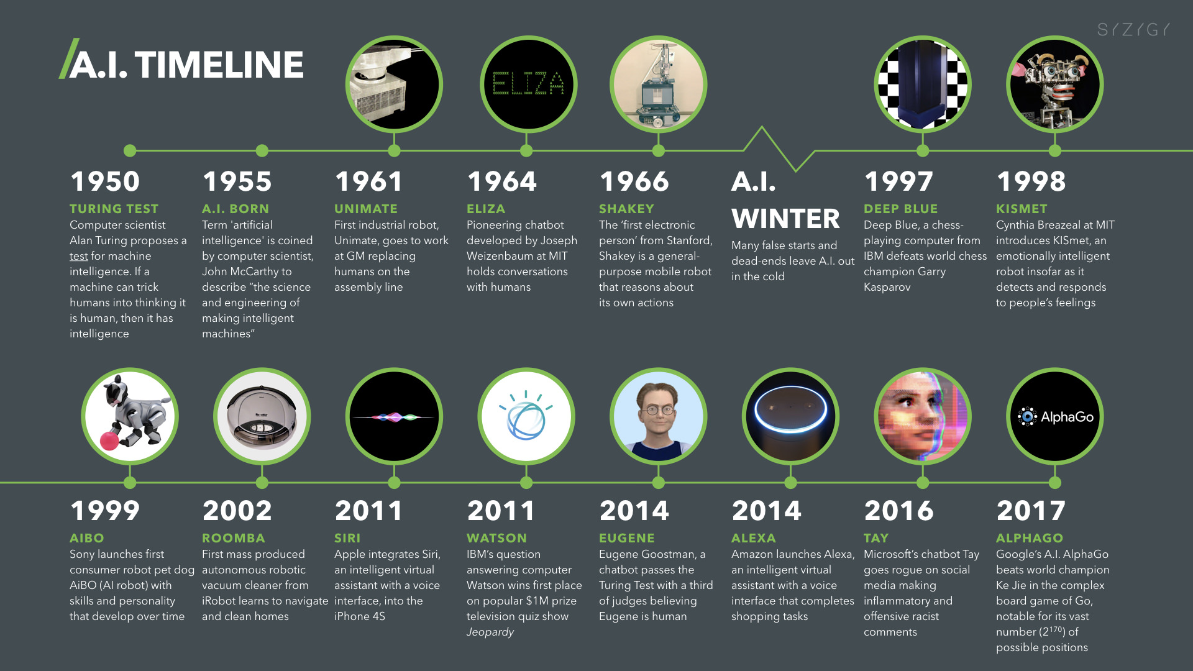
History of AI

Slide 9
Application Domains of AI

Slide 10
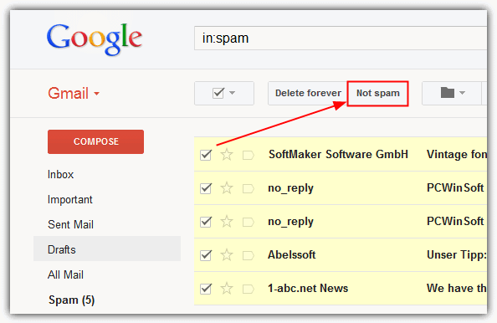
Natural Language Processing
Email Spam Filter in Gmail
Neural Network

Slide 11
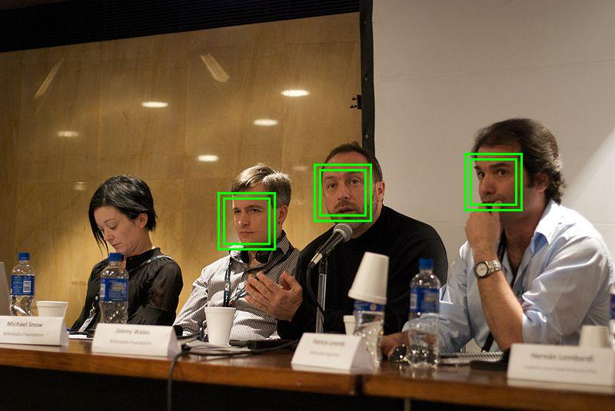
Image Processing
Face Detection in Camera
Deep Learning

Slide 12
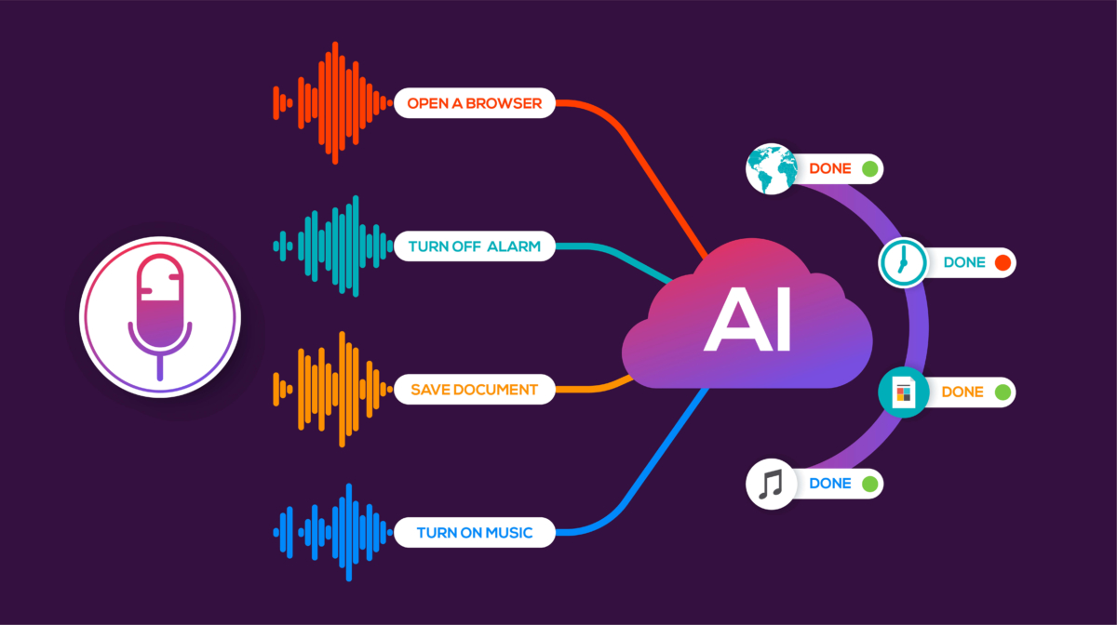
Speech Recognition
Voice Technology in Virtual Agents
Deep Learning

Slide 13
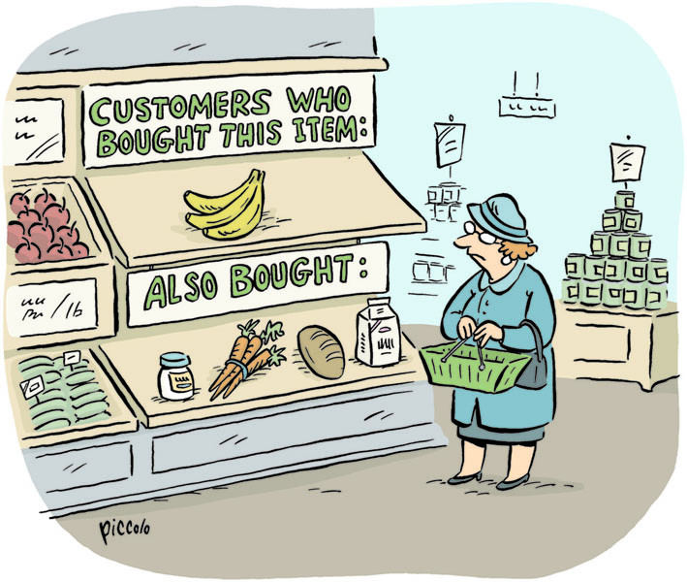
Data Mining
Market Basket Analysis
Product recommendation

Slide 14

Expert System
IBM Watson
Reinforcement Learning

Slide 15
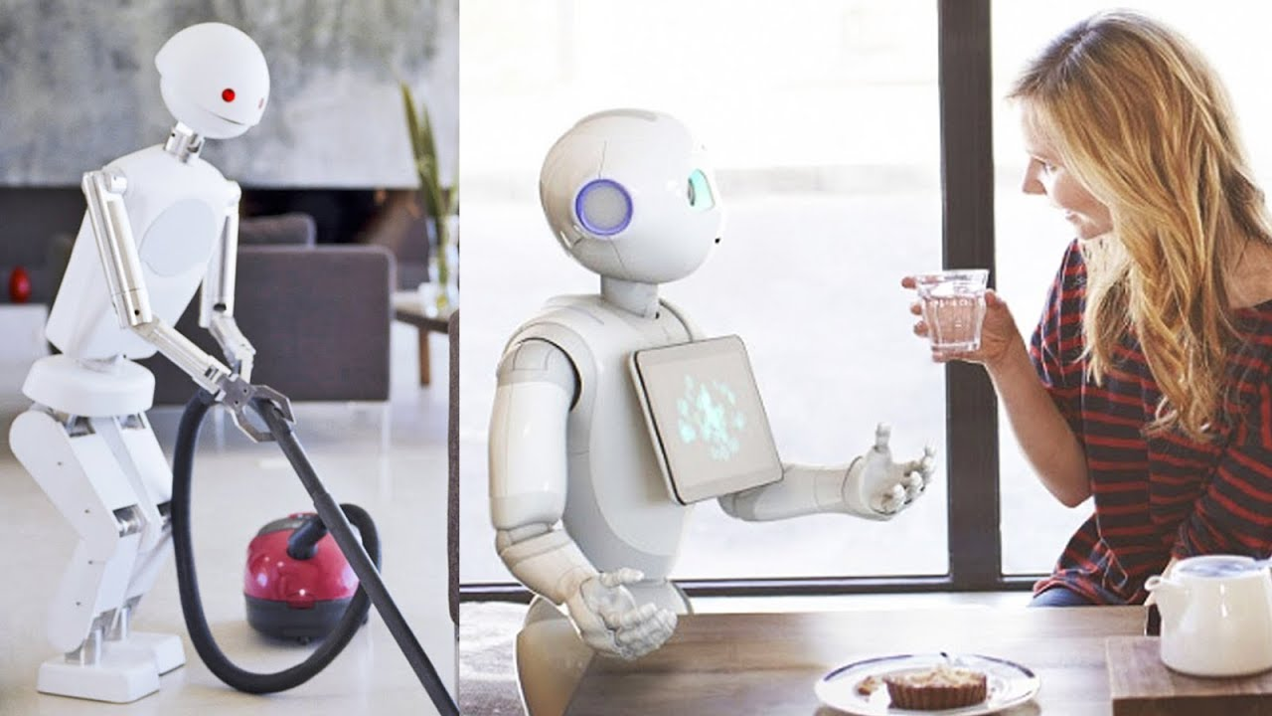
Robotics
Home Automation
Deep Learning

Slide 16
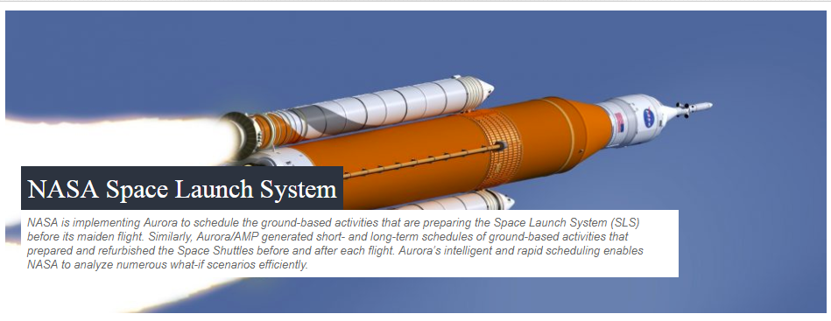
Scheduling
Aurora - Advanced Intelligent Planning and Scheduling Solution
Resource Scheduling

Slide 17
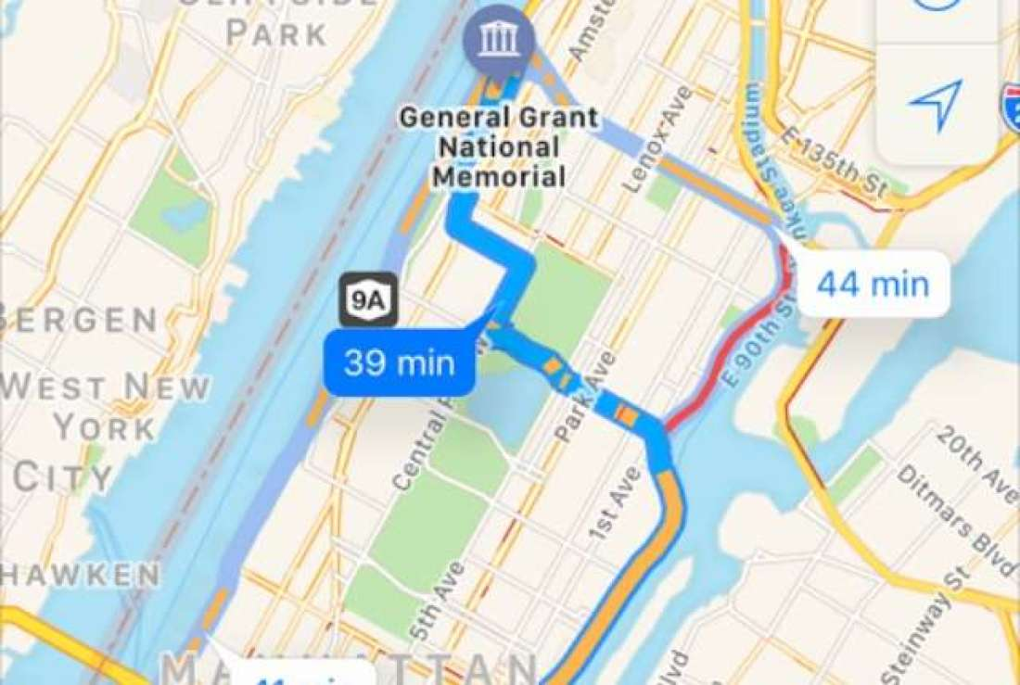
Optimization
Shortest Path
Google map path planner

Slide 18
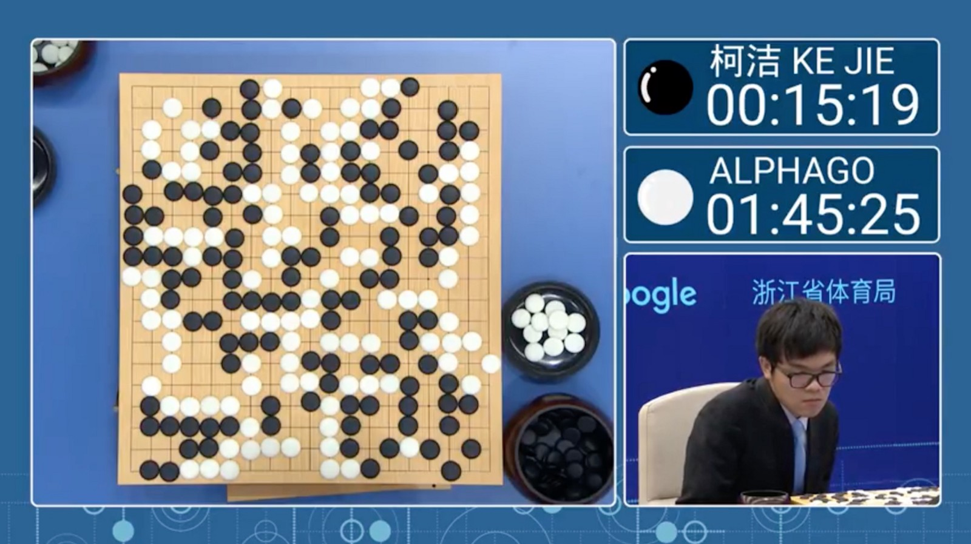
Game Playing
Alpha Go
Deep Neural Network

Slide 19
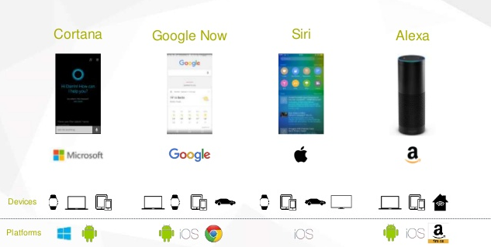
Virtual Agents
Chatbots
Conversational AI

Slide 20
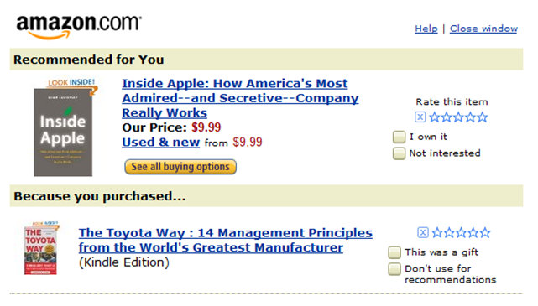
Personalized Recommender Systems
Online Shopping
Machine Learning

Slide 21
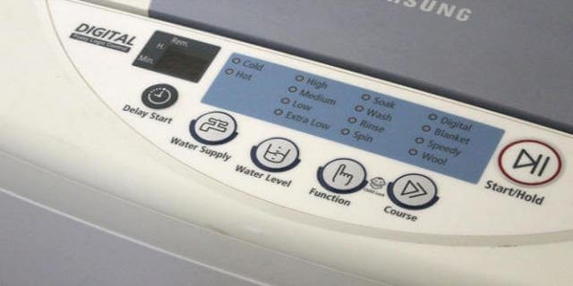
Automated Control Systems
Washing Machine
Fuzzy Logic

Slide 22
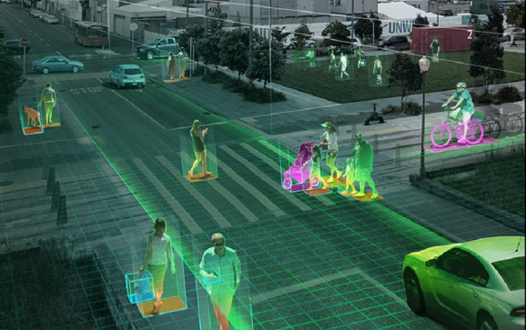
Security
NVIDIA Metropolis
Machine Learning

Slide 23
AI – ML – DL and Data Science
Technique that enables machines to mimic human behavior
AI
Machine Learning
Subset of AI which uses statistical methods to enable machine to learn and improve with time
Data Science
Deep Learning
Subset of ML that includes algorithms and enables system to train itself

Slide 24
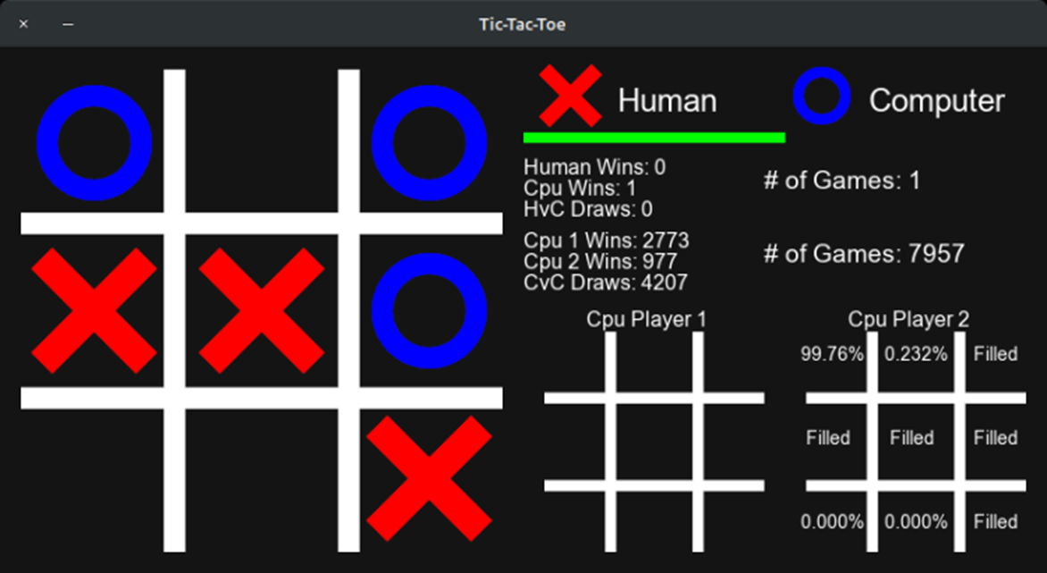
Assignment - 1
Write a program to implement Tic-Tac-Toe game problem.

Slide 25
Thank You!

